Slide 1
Large Scale Network Analysis for Online Social Brand Advertising
Kunpeng Zhang (KZ)
kzhang@rhsmithm.umd.edu

Slide 2
Outline
1. Introduction
2. Data
3. Framework
4. Evaluation
5. Summary
6. Toolbox

Slide 3
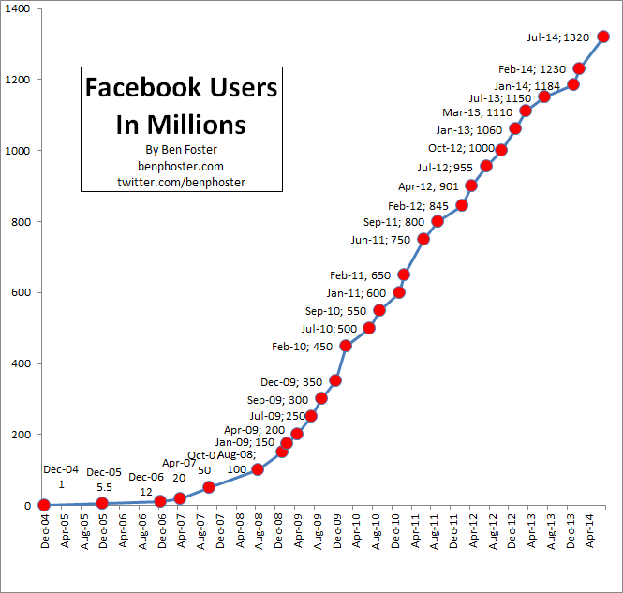
Social media is on the rise
Notes:
Americans were spending an average of 12 hours per month on social networks as of July 2012, with 18-24 year olds averaging 20 hours.
BIA/Kelsey recently forecasted $11 billion of social ad spend in 2017, up from $4.7 billion last year. Social media advertising, so far, only represents 1% to 10% of ad budgets for a wide majority of advertisers.

Slide 4
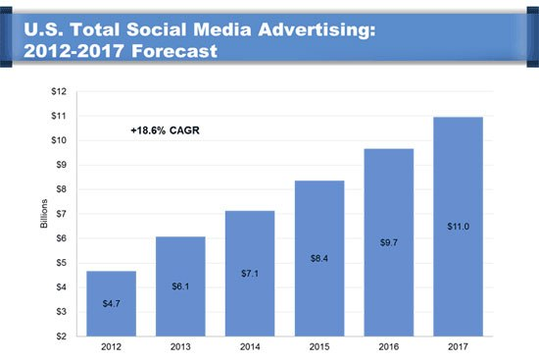
Social advertising is set to explode
Notes:
Americans were spending an average of 12 hours per month on social networks as of July 2012, with 18-24 year olds averaging 20 hours.

Slide 5
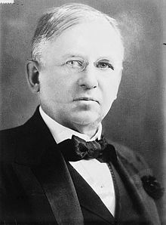
A popular saying
“Half the money I spend on advertising is wasted; the trouble is I don't know which half.”
John Wanamaker
Notes:
Postmaster general
Proponent of advertising and a pioneer in marketing

Slide 6

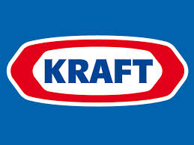
Traditional targeting
Select users who are
female
Select users who lives
in Chicago area
Select users who like
our brand
Build a user predictive model to select
………
This group targeting has the following disadvantages:
Data might not be accurate;
Focusing on one-many mapping (brand-user), ignoring user activities across brands;
No deep understanding user’s opinions;
Data is small.
Notes:
Tencent target youngers with low income

Slide 7

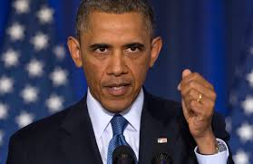

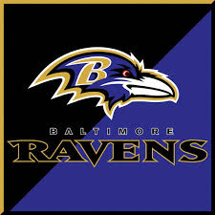

What we do
One user can like, make comments on multiple brands.
One brand can receive comments and likes from different users.
Select users by analyzing such a complex and large network.
…
…
Notes:
Brand could be anything……

Slide 8
Our contributions
Extract implicit brand-brand networks
Normalize networks to capture global and local information
Novel framework for audience selection
Hierarchical community detection
Influential brand identification
User sentiment analysis
Large real world dataset (~2.1TB) to test effectiveness of methods
Develop and implement MapReduce-based algorithms
Novel evaluation technique to test effectiveness of our targeting framework

Slide 9
Problem statement
For a focal brand (F), find a number of new users who are potentially interested in F based on their activities across different brands on social media.
Notes:
This focal brand is specific…become our fan or get engaged..

Slide 10
Data collection
Facebook graph API
13,000+ brands, 280M+ users
(posts, comments, likes, etc.)
Timeline (the first day on Facebook
to 2013)
Size (approximately 2.1 TB)
Notes:
Request limit: 20 machines, each has 10 ips, 20 accounts, randomly sleep…

Slide 11
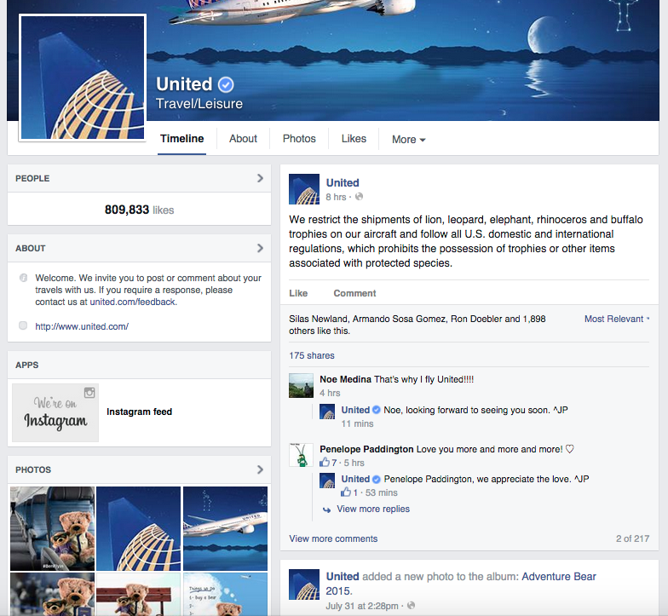
Number of fans
Post
Post like
Comments
Notes:
Share, they do not have share functionality until 2012

Slide 12
Data cleansing
Two-step
cleansing
Remove brands whose major comments are non-English (language identification).
Remove users who have less than 5 actions across brands.
Remove “spam” / suspicious users and their corresponding actions.

Slide 13
“Spam” user detection
Users (except the brand administrator) who
comment or like almost all posts (e.g., > 90%)
Step IV
Users who make many duplicated comments
and those comments contain URLs which
direct to phishing pages
Step III
Users who likes posts on an
extremely large number of brands
Step II
Users who have comments on an
extremely large number of brands
Step I
Notes:
A test on Barack Obama’s page, found 209,864 duplicated comments from same users out of 2,987,505 in total.

Slide 14
Data stats
The size of the data is BIG
After cleansing |  | After selecting top brands
# brands | 7,580 | 2,000
# brand posts | 13,206,402 | 3,793,941
# brand categories | 150 | 118
# unique users | 97,699,832 | 16,306,977
# likes | 5,275,921,875 | 1,688,274,379
# comments | 2,327,635,302 | 470,742,158
# positive comments | 651,231,870 | 179,009,470
# negative comments | 234,571,177 | 60,613,968
Notes:
Sacarsm: simple method

Slide 15
Framework for audience selection
Step 1
Step 2
Step 3
Implicit brand-brand network
Undirected and weighted
Directed and weighted
Network normalization
Network analysis
Brand selection
Closely related brands
Influential brand identification
User selection
Select users with high positivity score
Network Measures
Hadoop
Similarity + Influence
Hadoop
Sentiment Analysis

Slide 16

Overview of audience selection steps
Brand selection
I
1
III
10
45
30
56
197
2
1
93
IV
112
10
II
45
3
56
258
30
93
: focal brand
: selected brand
: brand
Number: influence rank
User selection based on user sentiment

Slide 17
Step 1: Undirected and weighted network
Framework >> Step 1 >> Undirected Network
Implicit undirected and weighted brand-brand network
Each node is a brand.
Two brands have a link if they have common users (having activities on both brands).
The weight of each link is the number of common users.
The weight of each node is the number of active users.

Slide 18
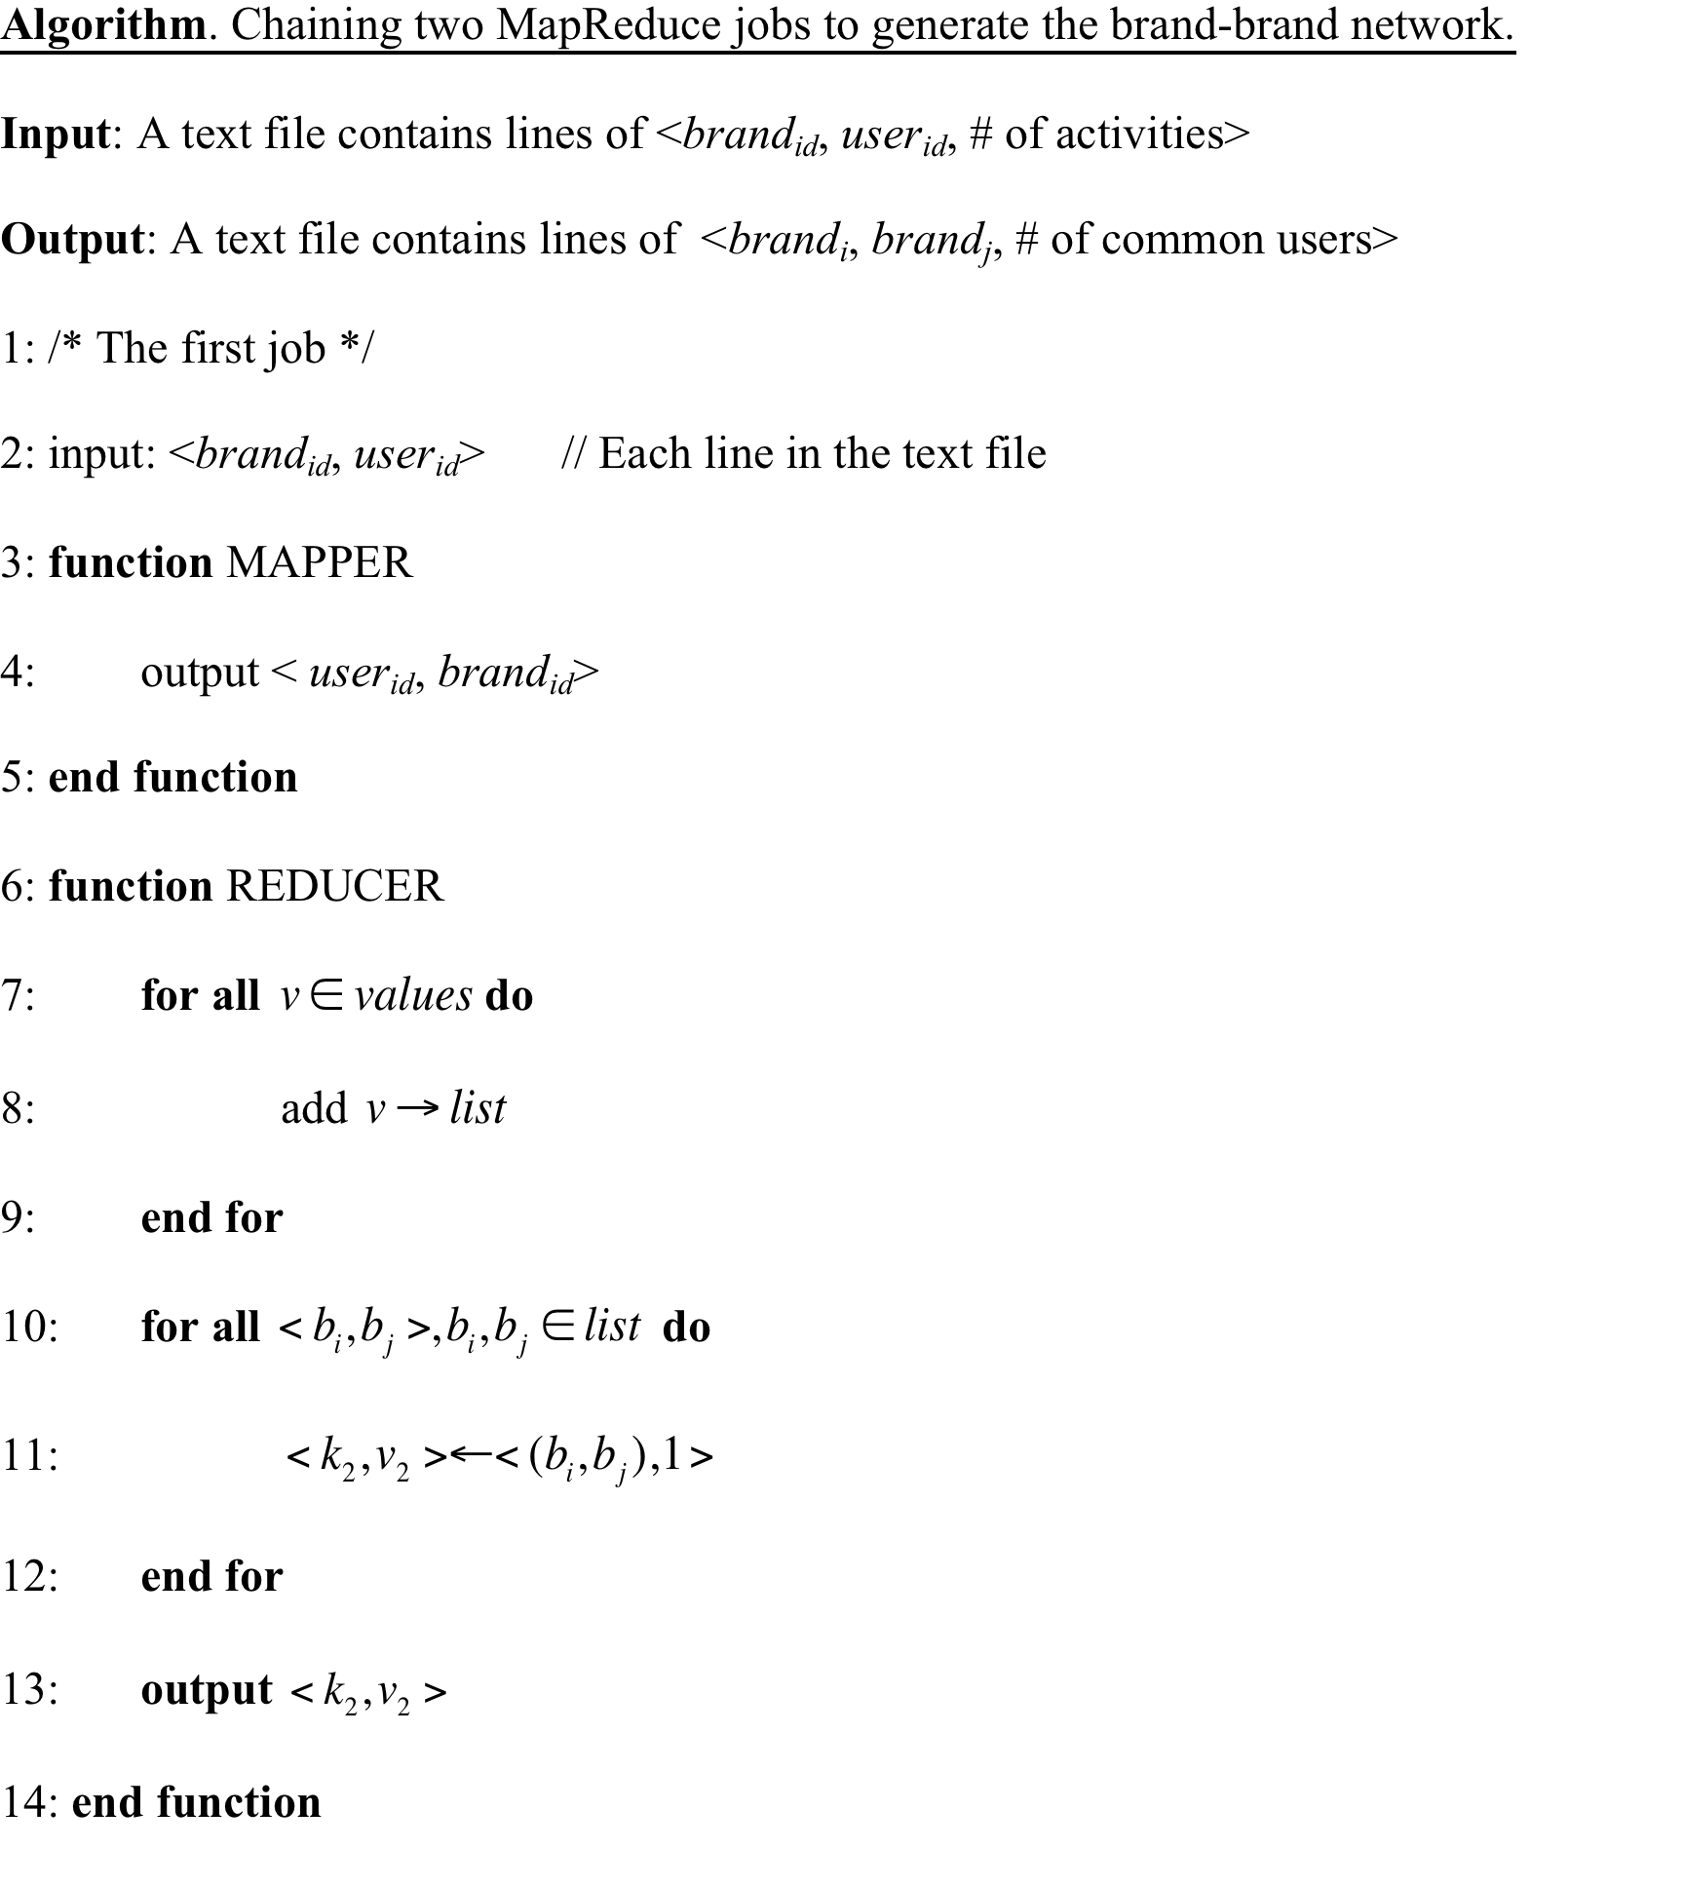
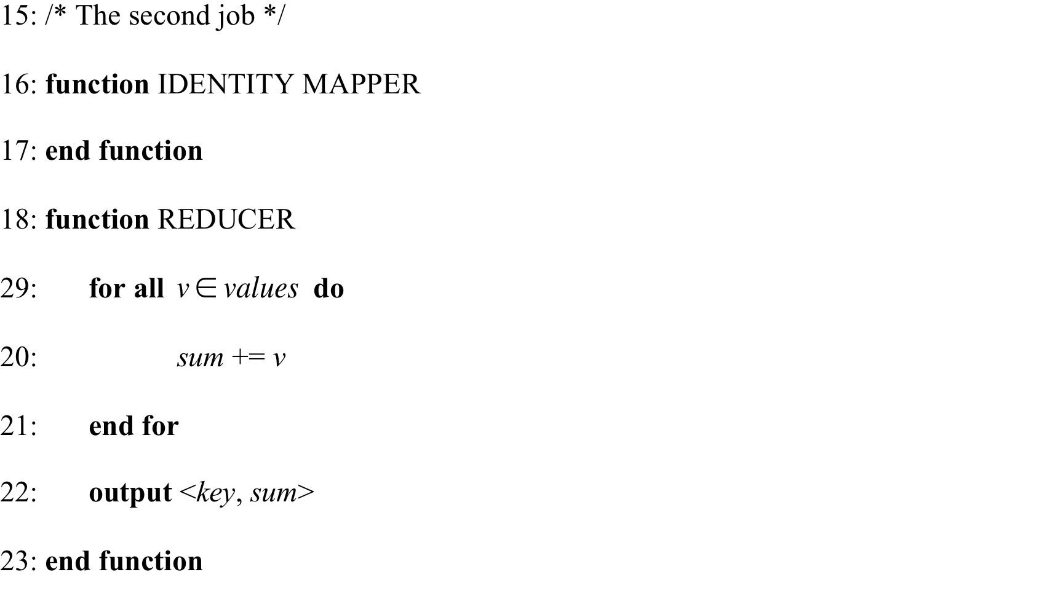
Algorithm
Framework >> Step 1 >> Network Generation
~50G
Requires more than a week of processing using a single machine, but with MapReduce using 11 machines takes less than 30 minutes processing time.

Slide 19

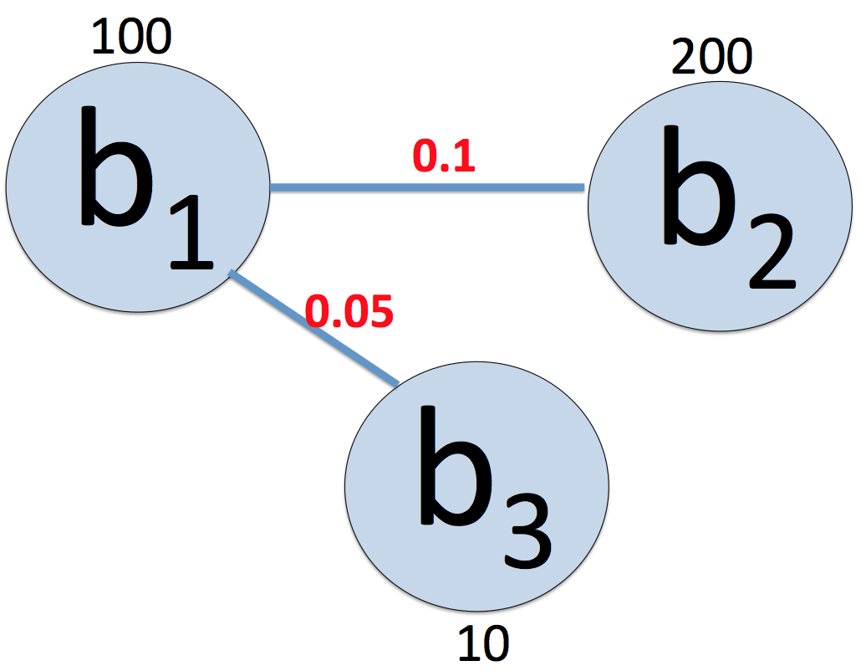
Network normalization
Framework >> Step 1 >> Network Normalization
Well-known brands typically attract more fans and have more common users with other big brands.
Comparison across brands in this network requires normalization of the link weights.
Normalize the weight by the global maximum weight
Because, it loses global network semantics such as the distribution of connection strength among links of a brand relative to the “size” of a brand

Slide 20
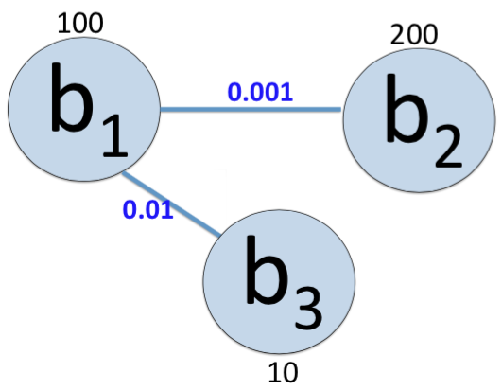
Network normalization
Framework >> Step 1 >> Network Normalization
First, normalize each individual link between two brands b_{i}, b_{j} by setting the intermediate weight.
Then, normalize all w’_{ij} by setting

Slide 21
Directed and weighted network
Framework >> Step 1 >> Directed Network
Implicit directed and weighted brand-brand network
Convert the undirected to directed by making each undirected link to two directed links

Slide 22
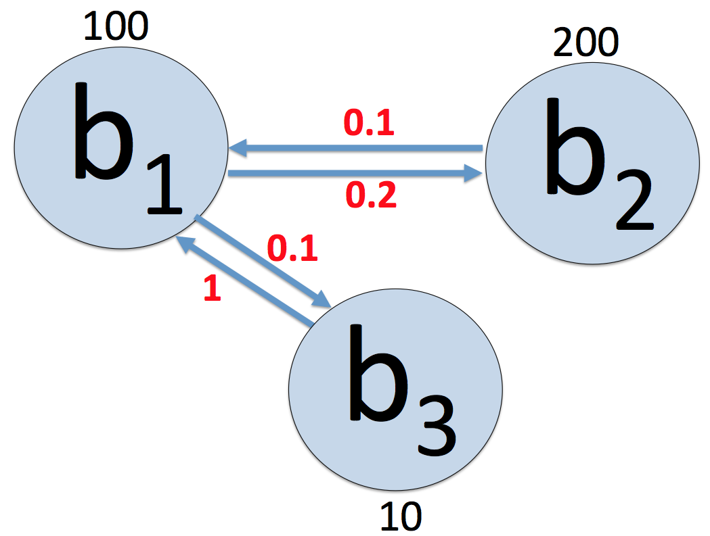
Network normalization
Framework >> Step 1 >> Network Normalization
For each link between two brands: b_{i}→b_{j}, we normalize the weight using the number of fans from its source brand.

Slide 23
Network structural properties
Framework >> Step 1 >> Network Measures
Network analysis
Degree
Density
Network measures
Eigenvector
centrality
Closeness
Betweenness

Slide 24
Node degree
Framework >> Step 1 >> Network Measures
A scale-free network.

Slide 25
Eigenvector centrality
Framework >> Step 1 >> Network Measures
Indicates the influence/importance of a node in our directed and normalized network.

Slide 26
Step 2: Brand selection
Framework >> Step 2 >> Brand Selection
Objective: Select influential,
closely related brands
Normalized undirected and directed networks
Similarity
Influence
Find closely related brands to the focal brand using hierarchical community detection
A user is likely to be interested in the focal brand if he/she is interested in a brand which is similar to the focal brand.
Rank all brands based on influence scores using brand ranking algorithm
Highly influential brands are more useful for audience selection.
Undirected
Directed
Combined
Selected brands

Slide 27
Example
Framework >> Step 2 >> Brand Selection
I
III
1
45
10
30
56
197
2
93
1
112
10
II
45
3
56
258
30
93
: focal brand
: selected brand
: brand
Number: influence rank

Slide 28
Hierarchical community detection
Framework >> Step 2 >> Brand Selection >> Community Detection
Having higher number of intra-community links as compared to inter-community links
Modularity maximization method [Newman, 2006]
Modularity reflects the concentration of links within communities compared with random distribution of links between all nodes regardless of communities.
Modularity (Q): the fraction of the edges that fall within the given communities minus the expected such fraction if edges were distributed at random
If Q = 0, then the system is randomly mixed.
If Q > 0, then there are more internal links than expected by chance.
K is degree
D is community assignment matrix
L is the total number of links
A is adjacency matrix

Slide 29
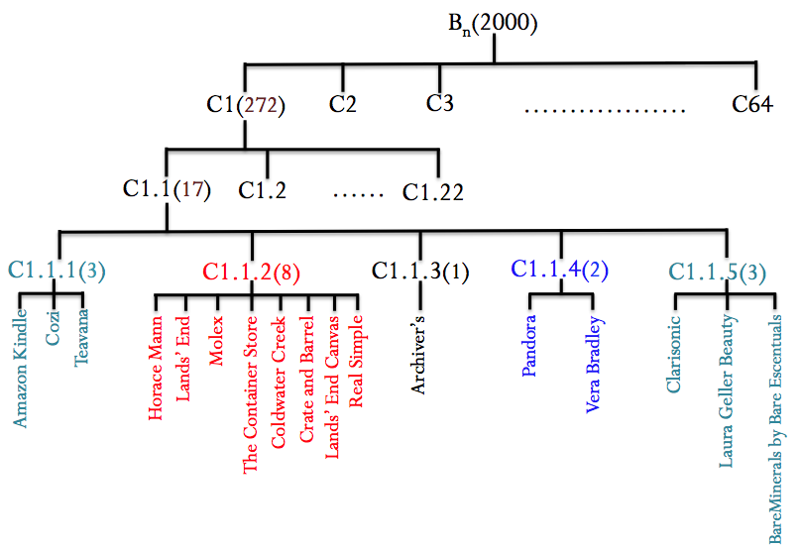
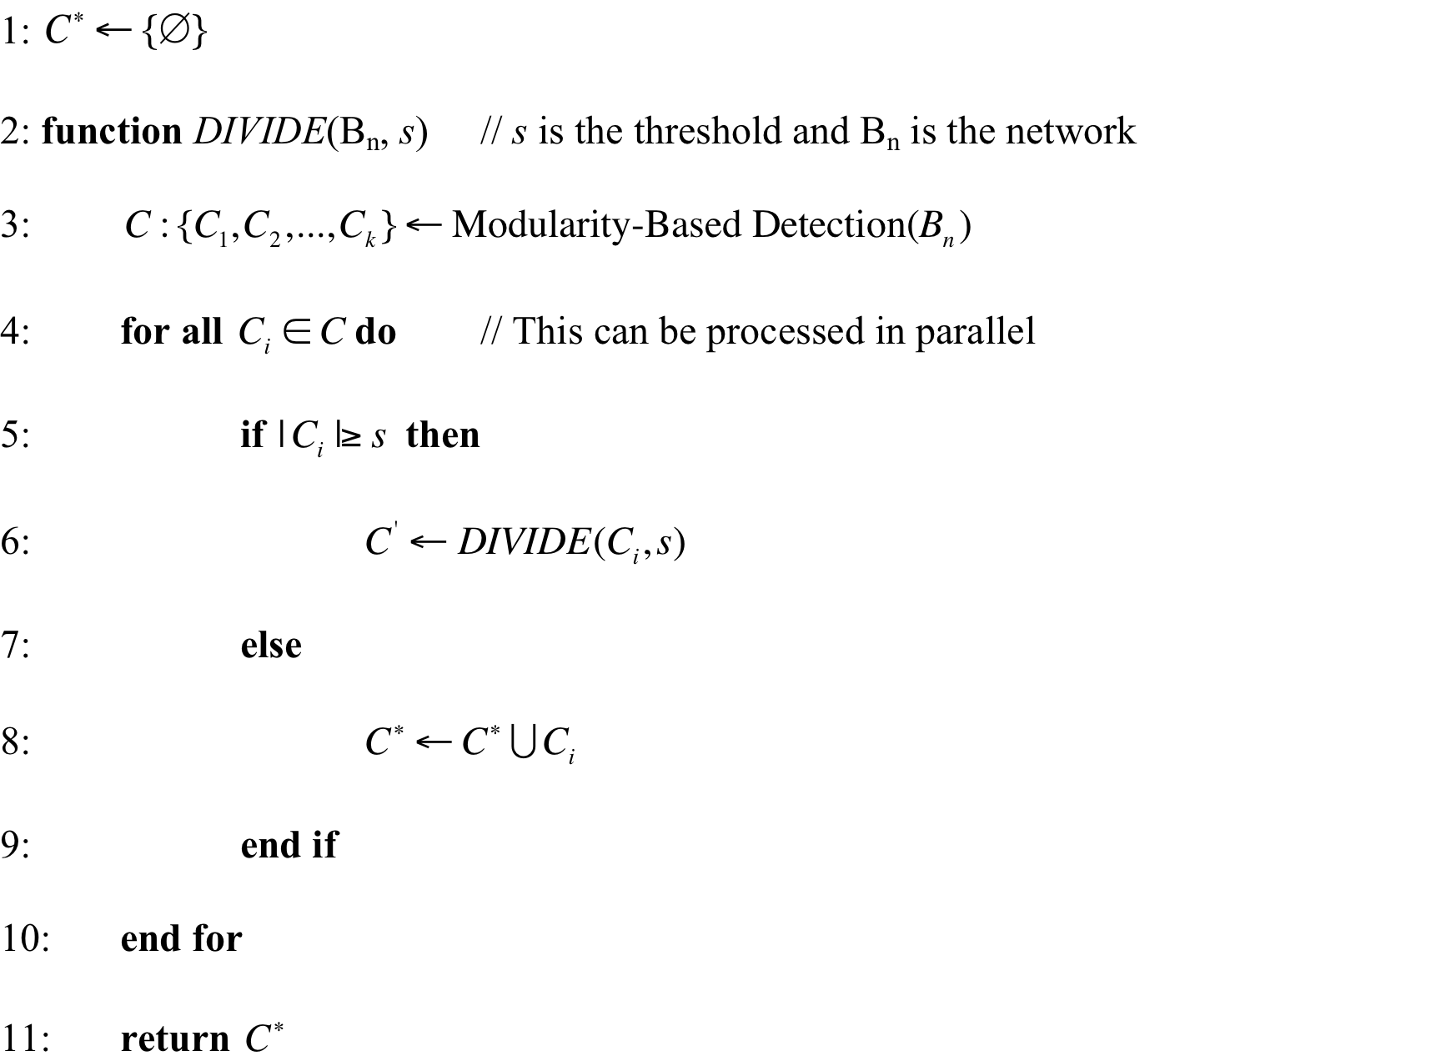
Algorithm
Framework >> Step 2 >> Brand Selection >> Community Detection

Slide 30
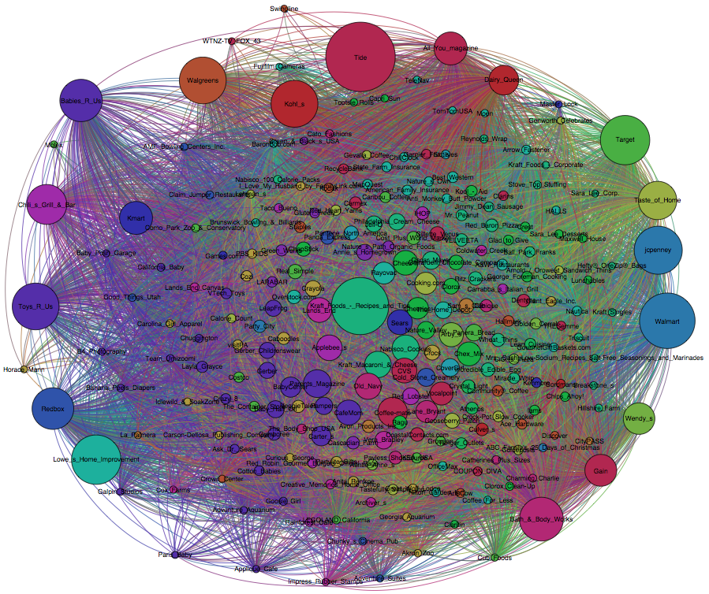

Slide 31
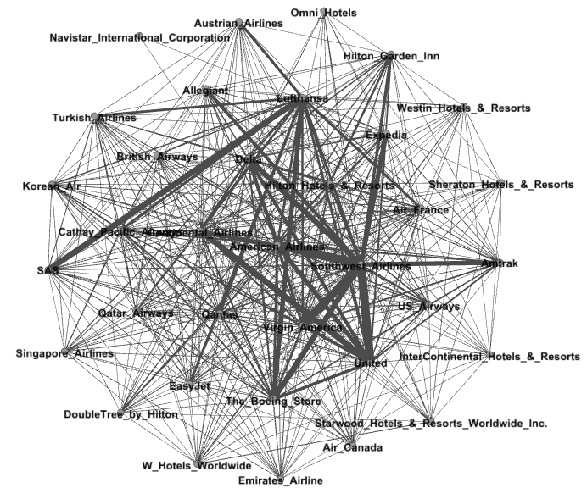

Slide 32
Brand influence/importance ranking
Framework >> Step 2 >> Brand Selection >> Brand Influence Ranking
The idea of the ranking algorithm
A brand with a large number of activities is considered to have higher importance.
A brand connected to an important brand will contribute more to its own importance score than one that is connected to a less important brand.
The connection strength represents the “importance votes” for the destination brand from the source brand.

Slide 33
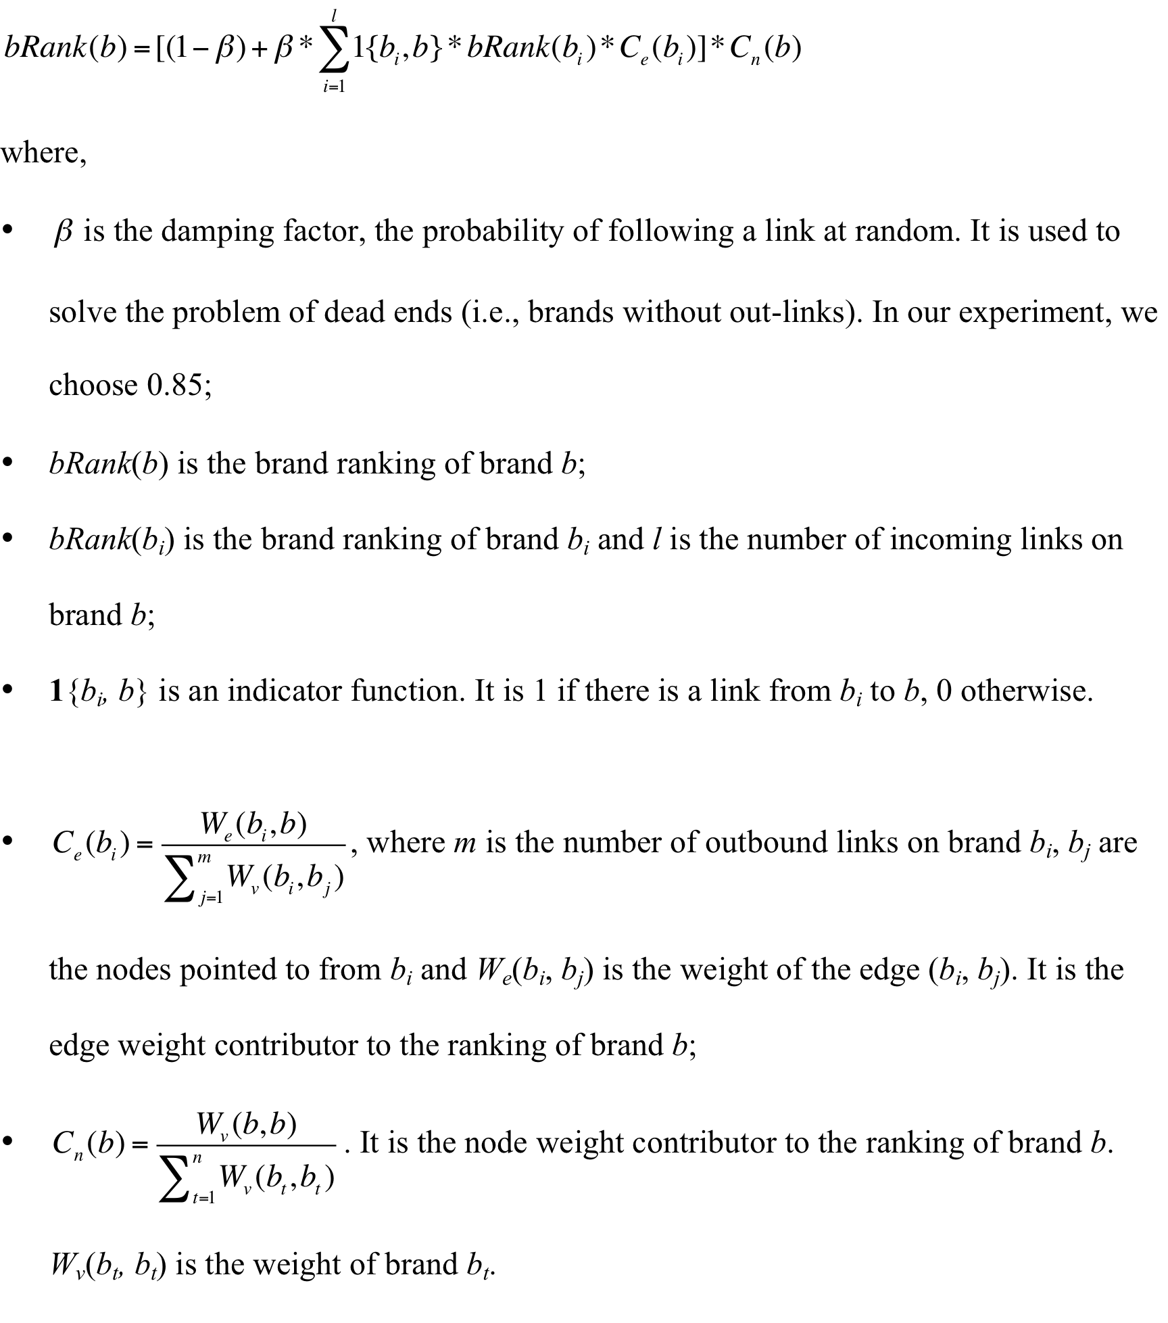
Algorithm
Framework >> Step 2 >> Brand Selection >> Brand Influence Ranking

Slide 34
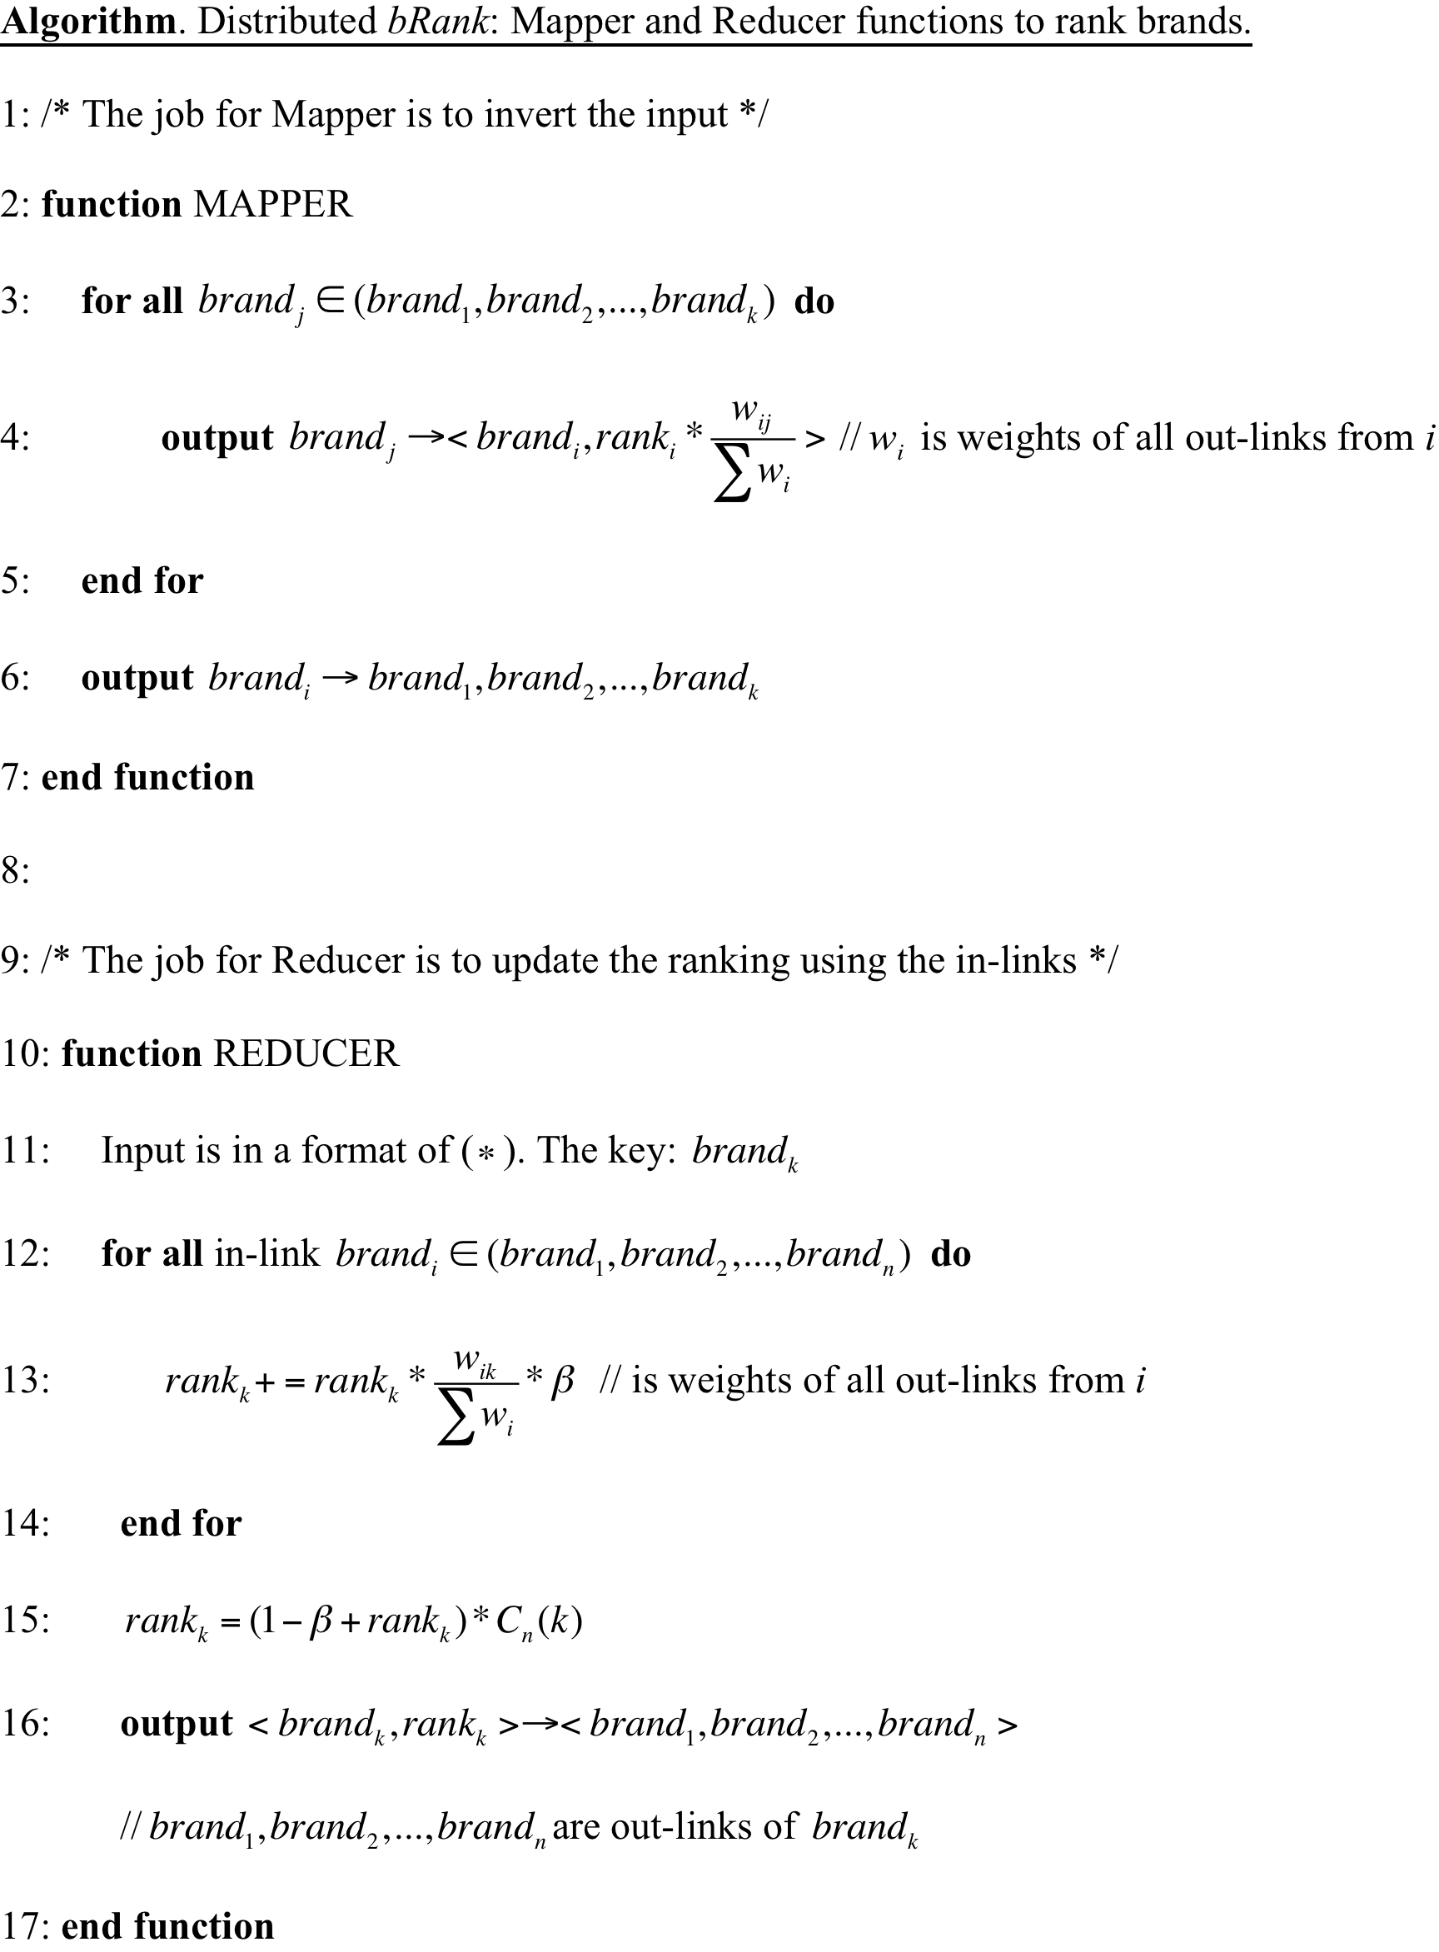
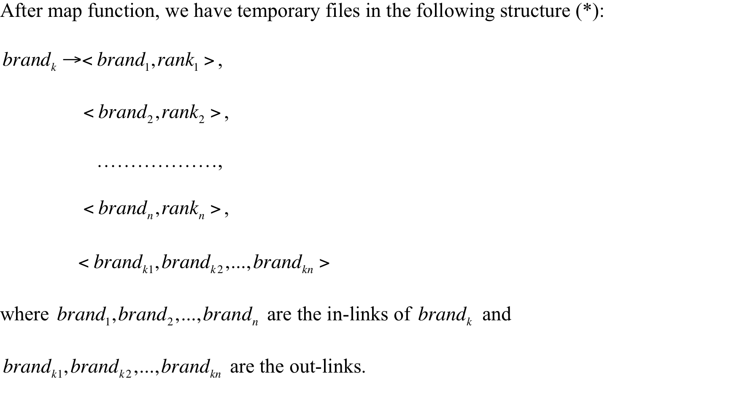
MapReduce implementation
Framework >> Step 2 >> Brand Selection >> Brand Influence Ranking
With MapReduce using Hadoop cluster, processing time is less than 3 minutes as compared to almost 20 minutes using sequential implementation.

Slide 35
Step 3: User selection
Framework >> Step 3 >> User Selection
I
1
III
10
45
30
56
197
2
1
93
IV
112
10
II
45
3
56
258
30
93
: focal brand
: selected brand
: brand
Number: influence rank
User selection based on user sentiment

Slide 36
User positivity
Framework >> Step 3 >> User Selection >> Sentiment Identification
Highly positive users are chosen from the user pool formed by the selected brands.
The sentiment classification (positive, negative, and neutral) accuracy is: 86%.

Slide 37
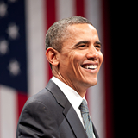
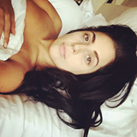







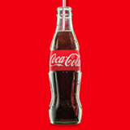


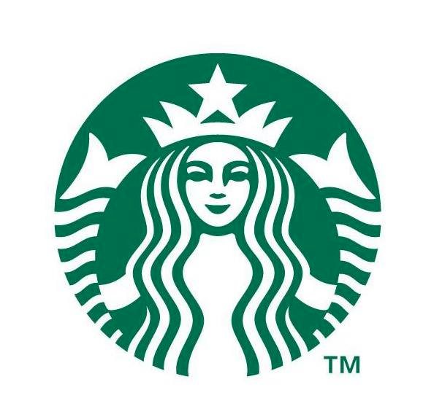

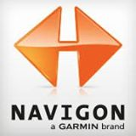





Influential brands
Top 10 influential brands
Bottom 10 influential brands

Slide 38
Evaluation
Examine whether the user we selected is really interested in the focal brand or not
Golden evaluation: “field” study
Place real ads based on our proposed strategy and other baselines
Compare click thru rates for both
It costs money and needs support from focal brands

Slide 39
Metrics
Liking posts
Becoming a fan
Measurements
Making positive comments

Slide 40
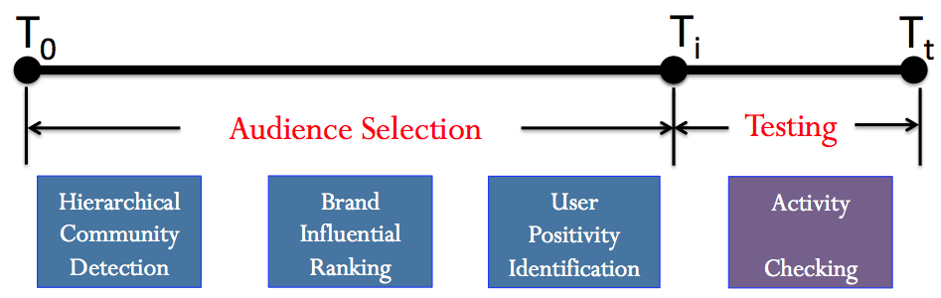
Our evaluation strategy
01/01/2009
05/01/2012
01/01/2013
Select new users
Check how many users who like or make positive comments.
Notes:
All companies must have facebook page by 2009

Slide 41
Baselines
BL₁: randomly choose users across all brands
BL₂: first select top k brands (b₁, b₂, …, b_{k}) which have highest number of common users with the focal brand, then randomly choose users from (b₁, b₂, …, b_{k})

Slide 42
Other strategies
Combination of similarity, influence, and user sentiment
P₁
Similarity
(community detection)
P₂
Influence
(brand ranking)
P₃
Sentiment
(positive users)
P₁ + P₂
P₁ + P₃
P₂ + P₃
P₁ + P₂+P₃

Slide 43
Focal brand selection
Sample 10 focal brands (F₁, F₂, …, F₁₀) from the brands with highest 20% ranking scores and brands with lowest 20% ranking scores, respectively.

Slide 44
Performance comparison
Performance: calculate how many selected users out of 100,000 have activities on the focal brand during the testing period.
High ranking brands
Brand name | BL₁ | BL₂ | P₁ | P₂ | P₃ | P₁+P₂ | P₁+P₃ | P₂+P₃ | P₁+P₂+P₃
Pepsi | 30 | 211 | 278 | 250 | 76 | 506 | 336 | 299 | 1,247
Nokia | 28 | 261 | 478 | 162 | 44 | 735 | 620 | 207 | 1,364
Mitt Romney | 25 | 1,008 | 1,149 | 792 | 324 | 1,886 | 1,323 | 1,056 | 3,821
Cristiano Ronaldo | 102 | 2,034 | 1,795 | 886 | 277 | 2,223 | 1,810 | 1,106 | 2,419
Mcdonald’s | 70 | 1,373 | 1,720 | 1,006 | 218 | 1,889 | 1,405 | 1,104 | 2,014
Starbucks | 63 | 1,508 | 1,043 | 792 | 173 | 1,695 | 1,620 | 1,015 | 2,107
Xbox | 60 | 300 | 407 | 331 | 107 | 1,044 | 770 | 392 | 1,521
Tide | 56 | 303 | 448 | 390 | 104 | 975 | 822 | 531 | 1,218
Chicago Bulls | 23 | 204 | 318 | 217 | 37 | 550 | 372 | 284 | 1,249
Windows Phone | 81 | 1,502 | 1,344 | 570 | 173 | 1,444 | 1,367 | 589 | 1,566

Slide 45
Performance comparison
Low ranking brands
Brand name | BL₁ | BL₂ | P₁ | P₂ | P₃ | P₁+P₂ | P₁+P₃ | P₂+P₃ | P₁+P₂+P₃
Vizio | 38 | 111 | 203 | 100 | 41 | 218 | 204 | 102 | 431
BMW USA | 36 | 282 | 414 | 263 | 55 | 653 | 458 | 321 | 1,401
Videograss | 18 | 95 | 126 | 78 | 45 | 177 | 132 | 90 | 225
Umbro | 58 | 420 | 464 | 271 | 82 | 612 | 457 | 390 | 739
Staples | 21 | 367 | 483 | 298 | 77 | 672 | 505 | 114 | 801
Baby Phat | 47 | 204 | 310 | 235 | 32 | 348 | 324 | 237 | 506
California Academy of Science | 18 | 124 | 202 | 117 | 19 | 260 | 193 | 120 | 271
Lands End | 27 | 251 | 683 | 275 | 150 | 769 | 704 | 166 | 1,604
Alternative Press | 36 | 120 | 197 | 94 | 22 | 216 | 202 | 107 | 417
Zegna | 13 | 78 | 102 | 67 | 14 | 118 | 105 | 71 | 153
BL₂ performs better than BL₁ (BL₂ is from the implicit brand-brand network)
P₁ performs better than BL₂
P₂ is not necessarily better than P₁
P₃ is not helpful individually
Combination of P₁, P₂, and P₃ performs the best
The framework performs better for high ranking brands than low ranking brands
Notes:
BL2 > BL1, BL2 is from the implicit brand-brand network. P1>BL2, P2 is not necessiarly better. P3 doesn’t help. But the recombination performs the best. Higher has better performance than lower brands.

Slide 46
Further analysis
“Conversion” lift
“Conversion” rate
N_{i} is the number of users having activities on the focal brand F_{i} during the testing period.
Notes:
Ratio…Engaged…

Slide 47
High ranking brands
Brand name | Brand size | Ranking score | CL₁ | CL₂ | CR (%)
Pepsi | 9,000,230 | 0.997 | 41.57 | 5.91 | 1.25
Nokia | 8,345,543 | 0.972 | 48.71 | 5.23 | 1.36
Mitt Romney | 7,546,493 | 0.900 | 152.84 | 3.79 | 3.82
Cristiano Ronaldo | 46,121,055 | 0.947 | 23.72 | 1.19 | 2.42
Mcdonald’s | 22,923,442 | 0.962 | 28.77 | 1.47 | 2.01
Starbucks | 30,723,302 | 0.961 | 33.44 | 1.40 | 2.10
Xbox | 1,809,066 | 1.000 | 25.35 | 5.07 | 1.52
Tide | 3,133,344 | 0.967 | 21.75 | 4.02 | 1.22
Chicago Bulls | 702,904 | 0.851 | 54.30 | 6.12 | 1.25
Windows Phone | 1,339,704 | 0.960 | 19.33 | 1.04 | 1.57

Slide 48
Low ranking brands
Brand name | Brand size | Ranking score | CL1 | CL2 | CR (%)
Vizio | 121,089 | 0.001 | 11.34 | 3.88 | 0.43
BMW USA | 772,563 | 0.095 | 38.92 | 4.97 | 1.40
Videograss | 12,136 | 0.001 | 12.50 | 2.39 | 0.23
Umbro | 353,593 | 0.001 | 12.74 | 1.76 | 0.74
Staples | 506,887 | 0.144 | 38.14 | 2.18 | 0.80
Baby Phat | 185,154 | 0.001 | 10.77 | 2.48 | 0.51
California Academy of Science | 53,561 | 0.287 | 15.06 | 2.19 | 0.27
Lands End | 947,109 | 0.217 | 59.41 | 6.39 | 1.60
Alternative Press | 121,097 | 0.001 | 11.58 | 3.48 | 0.42
Zegna | 88,846 | 0.093 | 11.77 | 1.96 | 0.15

Slide 49
Summary
Step 3: User selection
Step 2: Brand selection
User selection based on sentiment analysis
Evaluations
Step 1: Networks
Similarity + Influence
Hierarchical community detection to find closely related brands
Brand influence identification
Using various user-brand activities to build implicit brand-brand networks
Analyzing big networks
MapReduce (Hadoop), network analysis, text analysis

Slide 50
My toolbox
Text analysis
NLTK: http://www.nltk.org/
NLP: http://nlp.stanford.edu/software/
Topic modeling: https://radimrehurek.com/gensim/
Machine learning
Scikit-learn: http://scikit-learn.org/stable/
Bayesian statistics: http://bayespy.org/en/latest/
Network analysis
Graph-tool: https://graph-tool.skewed.de/
Gephi: https://gephi.org/

Slide 51
My toolbox
Image analysis
Scikit-image: http://scikit-image.org/
OpenCV
Data crawler
Selenium: http://docs.seleniumhq.org/
BeautifulSoup: https://www.crummy.com/software/BeautifulSoup/bs4/doc/
Python, Python, Python…

Slide 52
Thank You !
www.themegallery.com

